Slide 1

Next Hikes Project On
Pharmaceutical Sales prediction across multiple stores
By – Himanshu Saxena

Slide 2
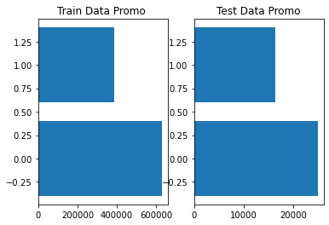
DISTRIBUTION OF PROMO IN TRAIN AND TEST DATA
We can see that Promotion is evenly distributed in Train as well as Test Data

Slide 3
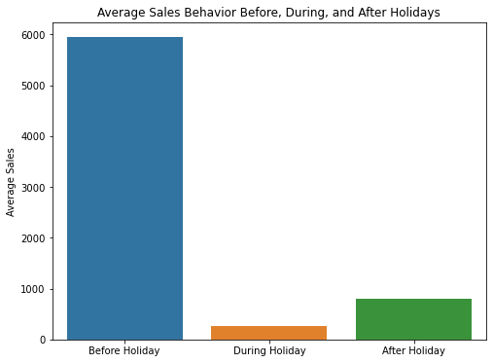
Average Sales Behavior - Holidays
Average Sales Before Holiday is high, During Holiday is Low and After holiday is slightly more than in During Holiday

Slide 4
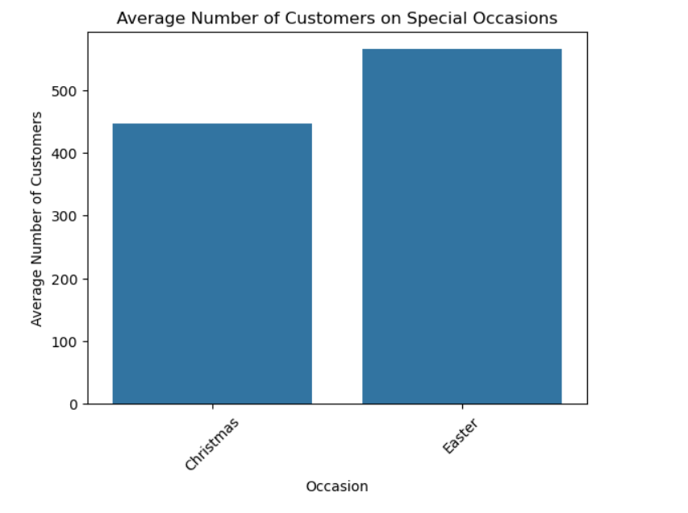
Average Number of Customers on Special Occasions
It is seen the Average Number of Customers is more During Easter

Slide 5
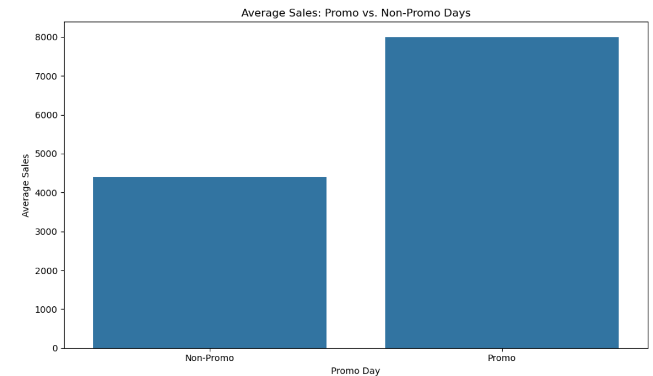
Average Sales and Customers During Promo
It is clearly seen that when Promo is there Average No. of Customers and Average Sales is high.

Slide 6
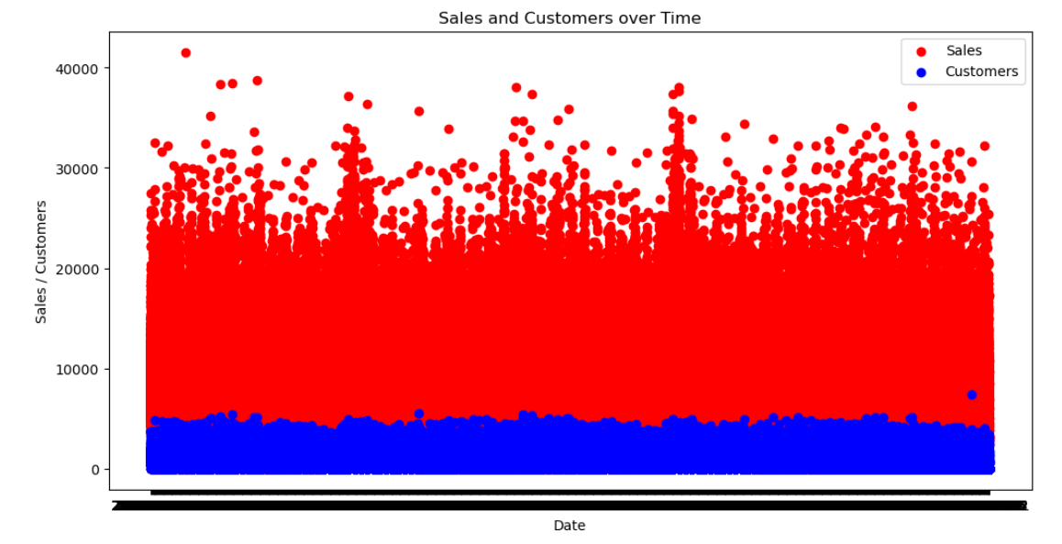
Sales and Customer chart from 2013-01 to 2015-09

Slide 7
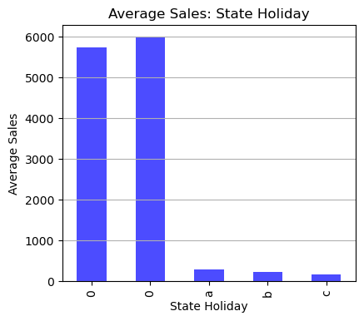
Average Sales on State Holiday

Slide 8
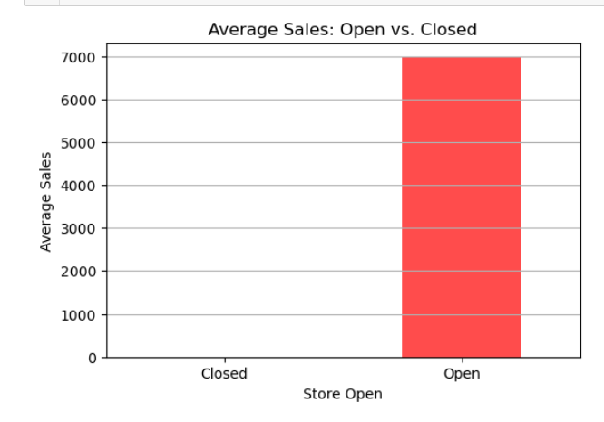
Average Sales when Store Open vs Closed

Slide 9
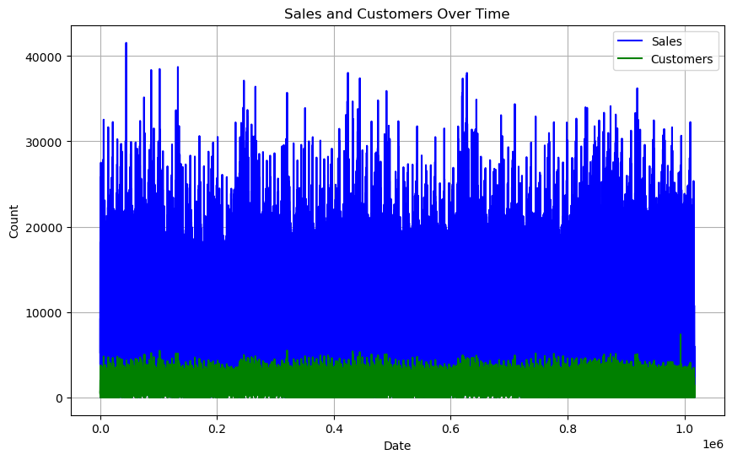

Slide 10
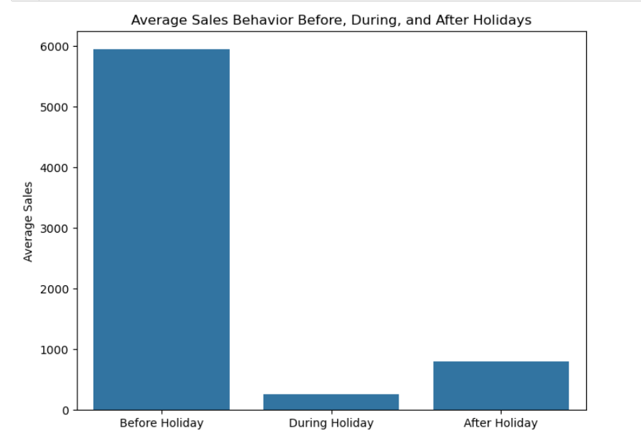
It is seen that Average Sales During Holiday Period is more as compared to a Regular Day and Before and After Holiday . Moreover we can see that sales is more on a regular day when compared with a day before or after Holiday .

Slide 11
MACHINE LEARNING MODEL PREDICTION
Regression Model MSE -> 2.707
Random Forest MSE -> 0.285
# Save the model using pickle
import pickle
with open('forest_regressor.pickle', 'wb') as f:
pickle.dump(model, f)

Slide 12
RNN and LSTM Prediction
MSE OF RNN → 2.0429
MSE OF LSTM -> 6.072

Slide 13
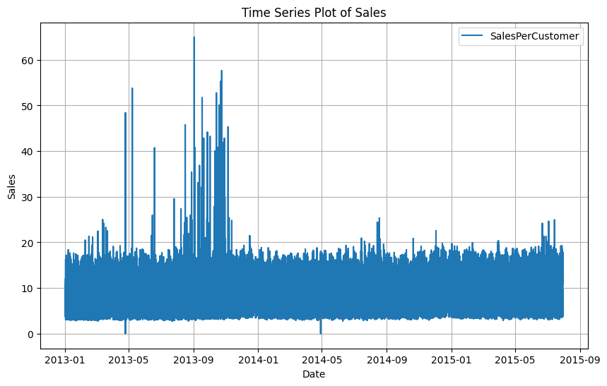

Slide 14
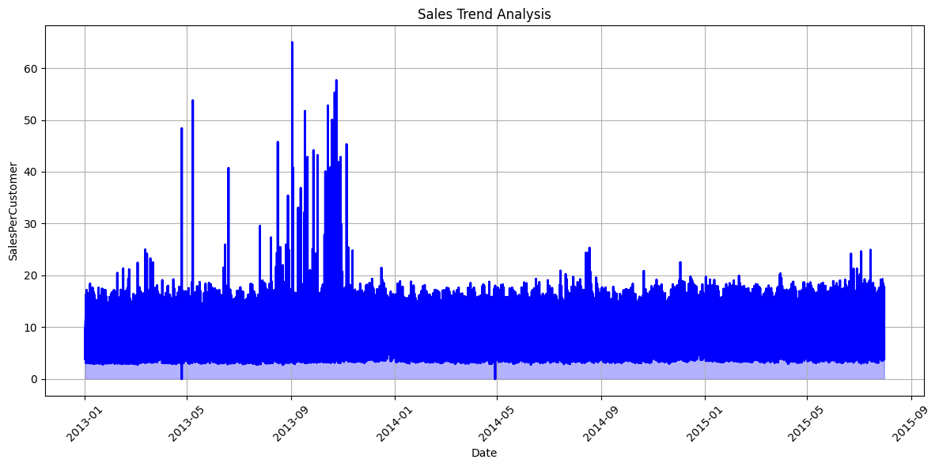

Slide 15
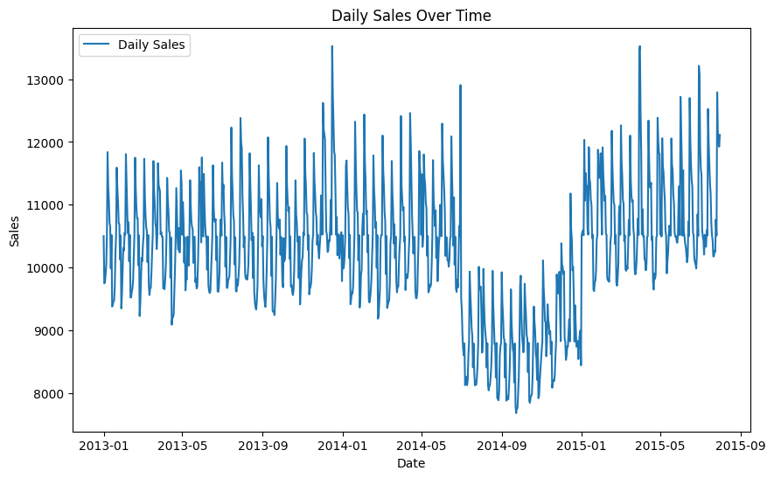

Slide 16
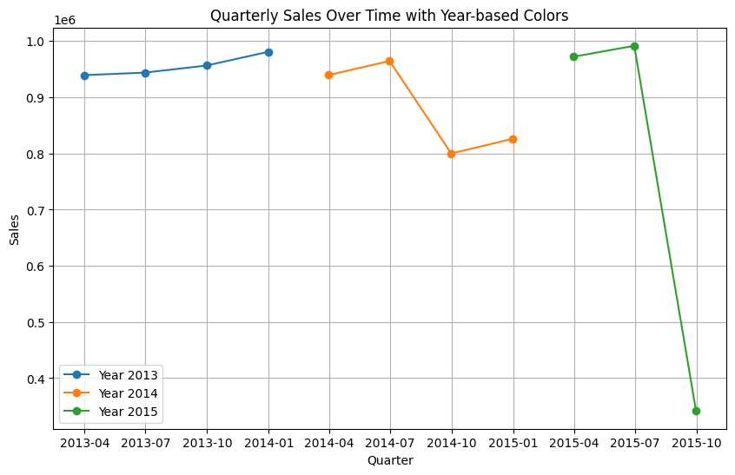

Slide 17
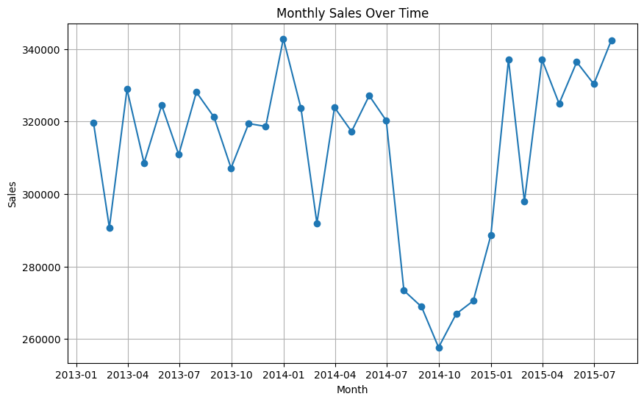

Slide 18
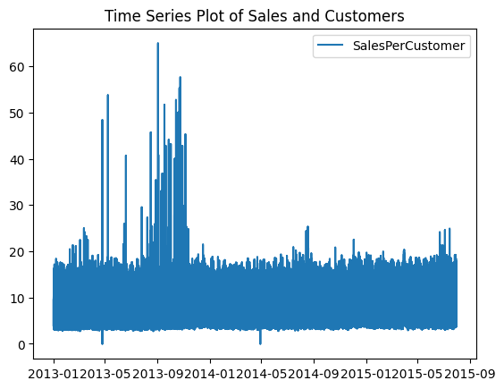

Slide 19
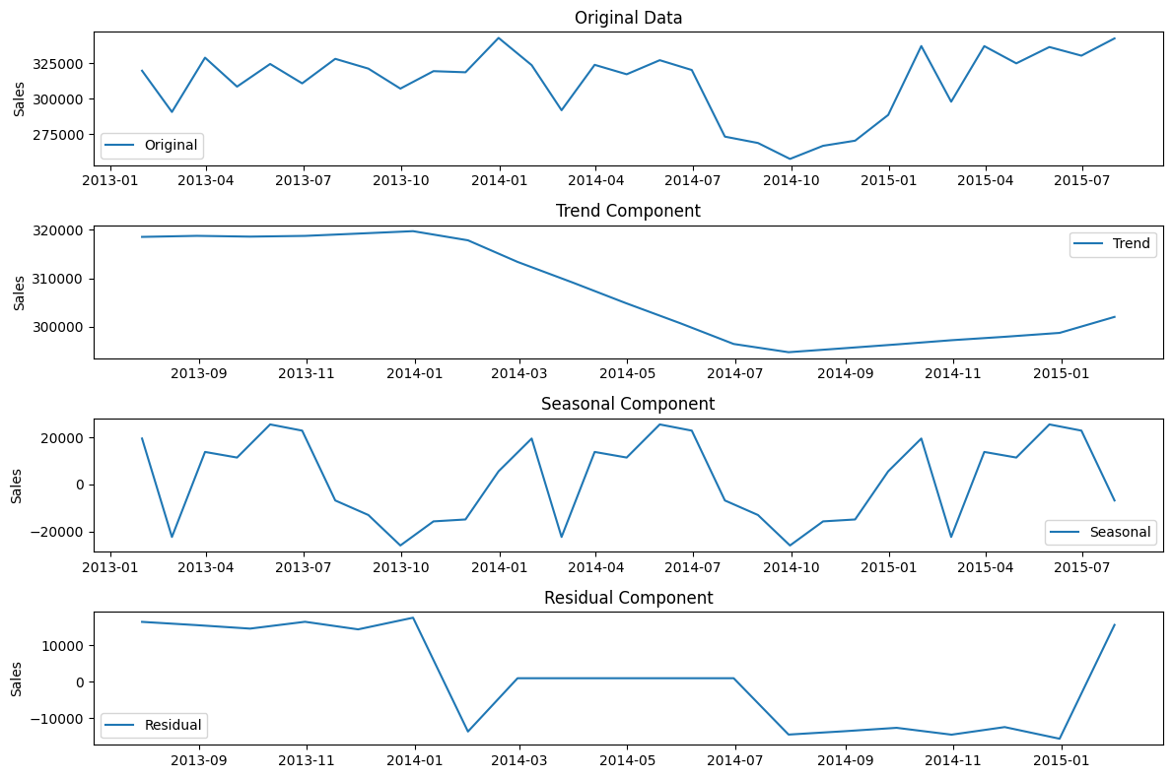

Slide 20
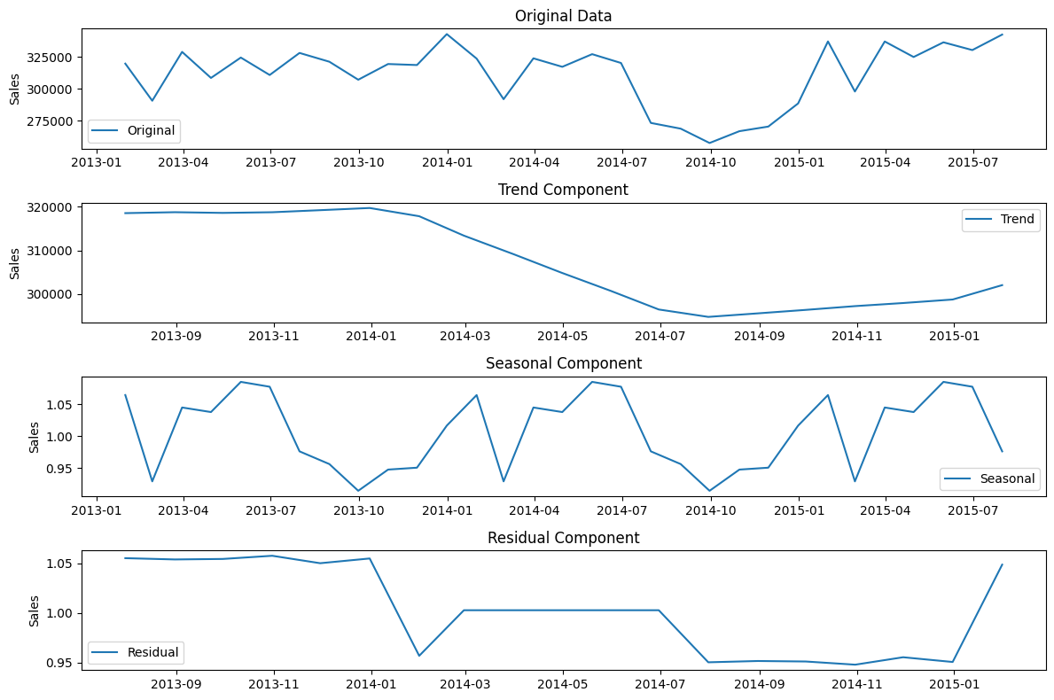

Slide 21
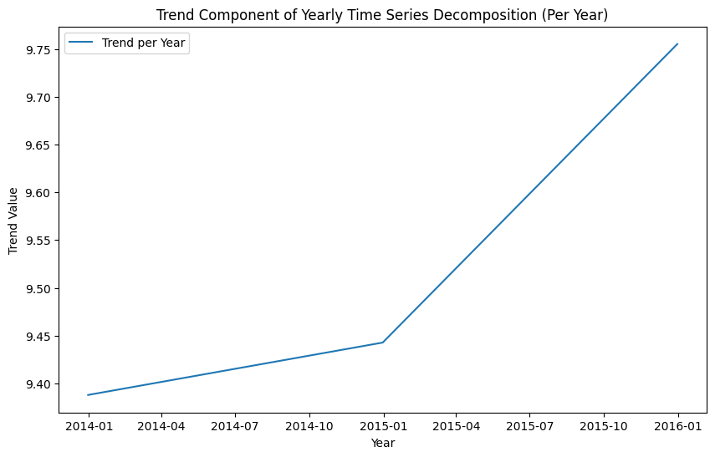

Slide 22
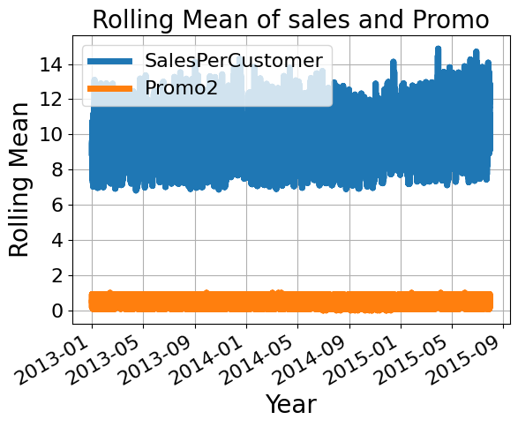

Slide 23
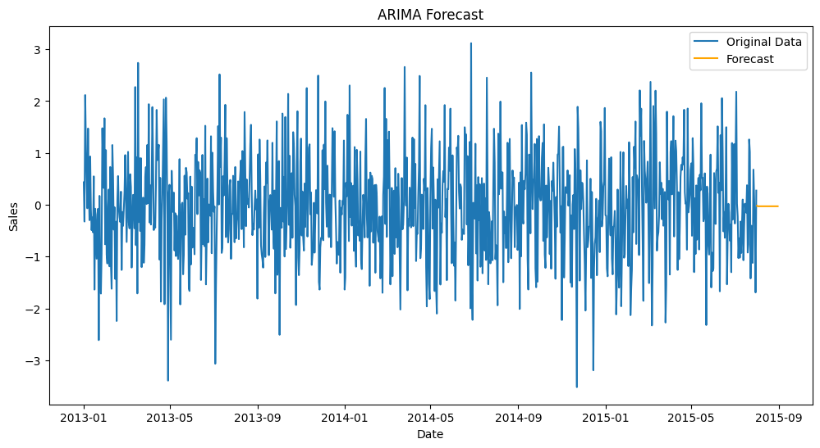

Slide 24
